Slide 1
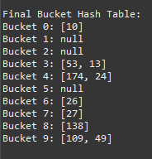
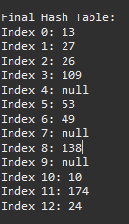
Hashing Lab
1. Given the following key values, show what the data structures would look like after insertions
27 53 13 10 138 109 49 174 26 24
(no preprocessing necessary: p_{k} = key)
Linear array of 10 elements using division hashing
and the linear-quotient collision path algorithm
N = 13, 4k+3 prime = 19
LQHashing:
1. ip = pk % N
2. q=pk/N
if (q%N != 0)
offset = q
else
offset = 4k+3 prime
3. While collisions:
ip’ = (ip + offset) % N
4. Set Array[ip]=key
Bucket hashing of 10 elements (N=10) ip = (p_{k}) % N
Array:
Array:
0
1
2
3
4
5
6
7
8
9
10
11
12
13
0
1
2
3
4
5
6
7
8
9
10
27
null
26
null
109
53, 13
null
174,24
53
null
49
26
null
27
138
138
null
109, 49
10
174
24

Slide 2
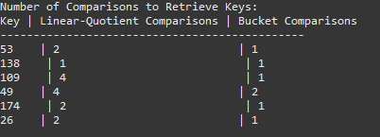
2. Fill in the table based on exercise 1
Number of comparisons to retrieve this element
Key
Linear array -
(Length of
Collision Path +1)
Buckets -
(# of elements
in linked list
compared)
53
2
1
138
1
1
109
4
1
4
2
49
174
2
1
2
26
1

